Slide 1
Group 7 - Homicide Project Presentation Members: Lint Tobias, Wiskott Christian, Sumesgutner Ava, Wohlleben Kilian VU Doing Data Science WS21

Slide 2

Data Set
What we were working with:
the complete Uniform Crime Report data summarizing all homicides and homicide clearances reported from 1976 to 2020 - 45 years’ worth of data
827,219 victims (instances) related to 789,664 incidents (IDs)
Some of the initial conspicuities
31 features in the data set
only the first offender listed in the original report is included in the dataset also, the information on the offender(s) of a case can be incomplete or completely unknown
the USA recognizes 6 distinct races, but only two ethnicities: Hispanic/Latino and Not Hispanic/Latino
the definition of the metropolitan statistical areas changed over time - the feature isn’t 100% consistent.
the feature state reported 52 unique values, but the US has 50 states
the data set includes both original reports and adjusted reports that overwrote previous reports

Slide 3
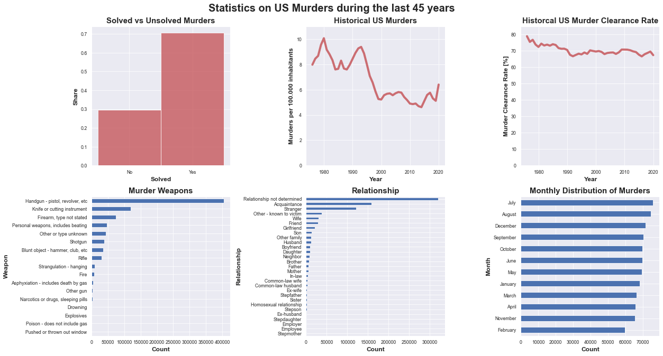
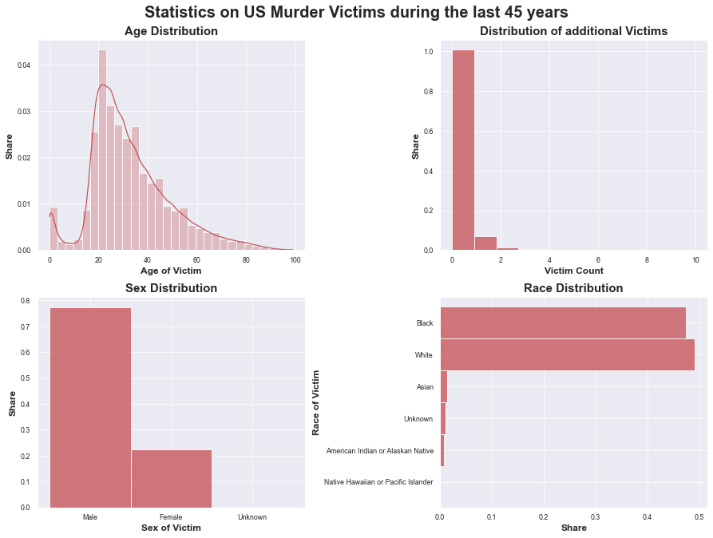
Data Understanding
Unbalanced data set with 70% solved and 30% unsolved murder cases.
Overall decline in murders per capita over the last 45 years, but rising again since 2014 with a sharp increase in 2020.
Steady murder clearance rate of around 70% since 1990.
Vast majority of murders carried out using handguns, followed by knifes and other types of firearms.
For most murders the relationship of victim and offender could not be determined. The most common known relationship however is acquaintance.
During the months of July and August there have been the most murders although the winter months of December, September and October follow closely behind.
Most of the victims were around 20 years old. Distribution decays exponentially with growing age.
The overwhelming majority of murders only have one victim.
Around 78% of victims where male and 22% were female.
The share of black vs. white victims was almost 50/50 over the last 45 years.
Due to the way the data was generated by the source, no reliable insights about the offenders could be derived.

Slide 4
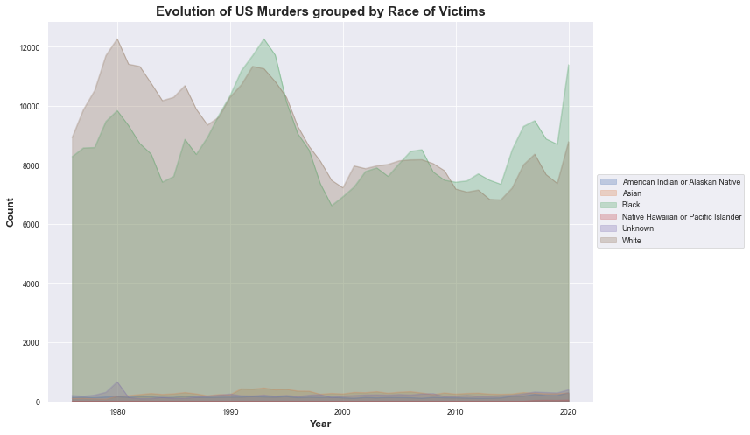
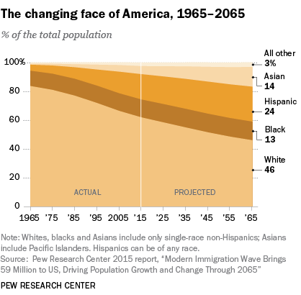
Data Understanding
Roughly same number of white and black victims from 1990 to 2010, although since 2010 the number of black victims seems to increase faster than those of white victims. Shows that despite the shrinking share of white citizens, with black citizens making up only about 13% of the population (consistent during the last decades, see the graph below) black citizens are disproportionally affected by murder in the US.
Alarming rise in murders overall in 2020.

Slide 5
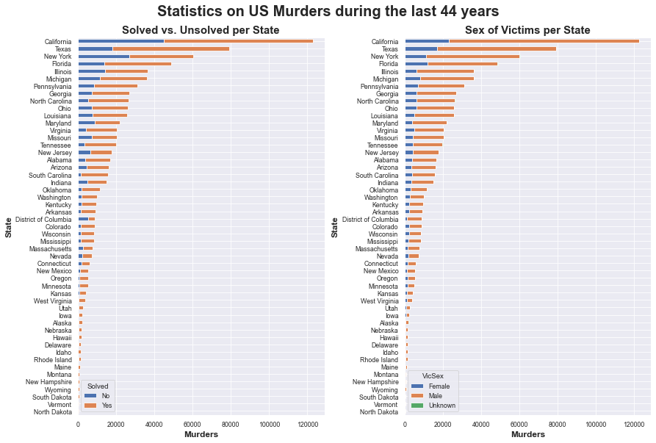
Data Understanding
Texas seems to have (compared to states with similar number of murders) a relatively high murder clearance rate while New York has a clearance rate of only about 50%. District of Columbia has an even worse clearance rate of only about 25% over the last 45 years.
Looking at the distribution of sex of victims on a state-by-state basis reveals no obvious cases where disproportionately many women or men have been murdered. In almost all states the proportion of male vs. female victims is roughly 80/20.

Slide 6

Challenge
Core question:
Can we, based on various features of previous murders like the state, the year or the murder weapon, predict if a new murder case will be solved?

Slide 7
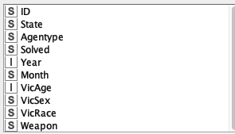
Feature Selection
The variables included in the following:
ID: a unique record identifier
State: state of the originating agency making the report
Agentype: the type of law enforcement agency according to the FBI numbering scheme
Solved: whether the offender was identified at time report was made or not
Year: year of homicide occurrence or when the victim’s body was recovered
Month: month of homicide occurrence or when the victim’s body was recovered
VicAge: Age of the victim; 1-98 is the actual age, 99 is anyone 99+, 0 is anyone below one year of age, 999 is any unknown age
VicSex: whether the victim was male, female or if it is unknown
VicRace: the race of the victim
Weapon: the weapon used in the crime

Slide 8
Modelling and Results
At first we're using an 80/20 Train test split.
We're performing equal size sampling on the training set to get a balanced dataset.
Then we try three types of models:
Logistic Regression, as it is a very simple model, that allows for interpretability
A Decision Tree, that is even more interpretable
And A Multi-Layer-Perceptron to gain the best results. This however is a Black-Box model
Another approach was using a Support Vector Machine, but as the data size was too large and training took too long so we abandoned that approach
We also tried building an ensemble but the results were worse than the individual models
We're evaluating all three models with the KNIME Scoring function that gives the Confusion matrix and all the related metrics
We also look at the ROC Curve and evaluate the Area under the Curve

Slide 9
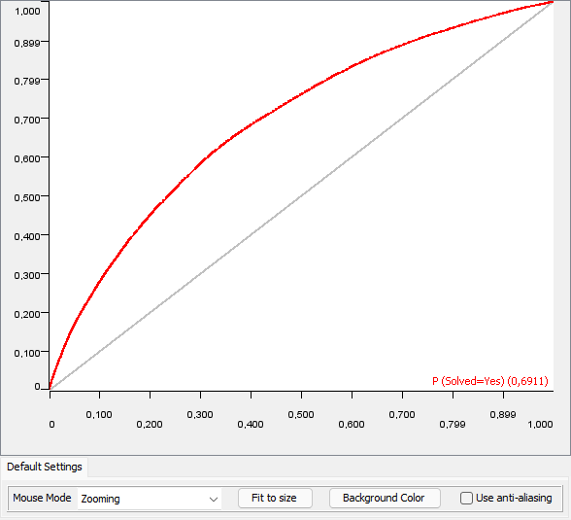
Modelling and Results
Results | Logistic Regression | Decision Tree | Neural Network
Accuracy | 0.633 | 0.665 | 0.662
Cohen's Kappa | 0.244 | 0.287 | 0.293
AUC | 0.691 | 0.718 | 0.733

Slide 10
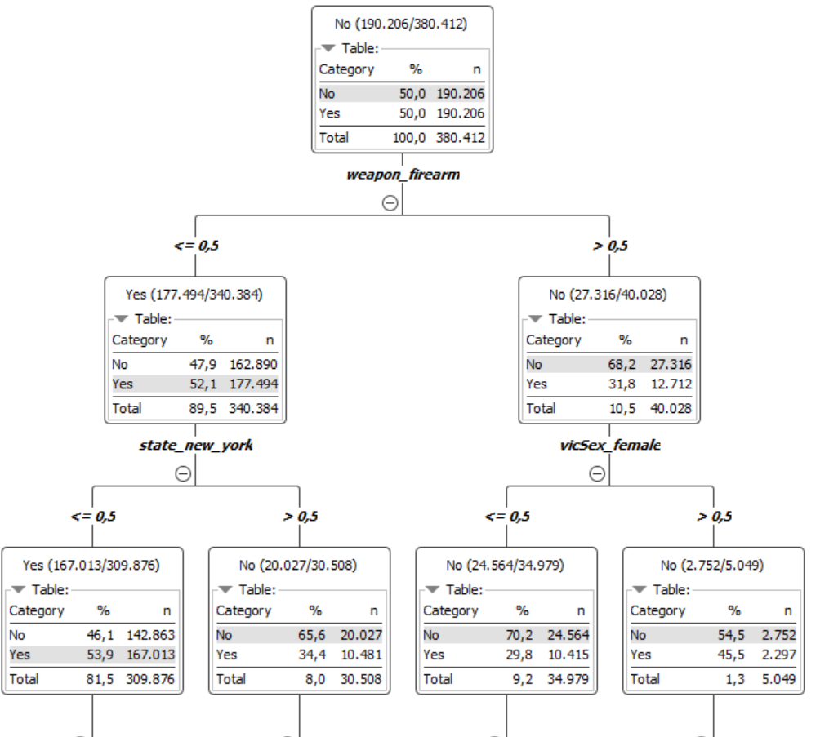
Modelling and Results

Slide 11
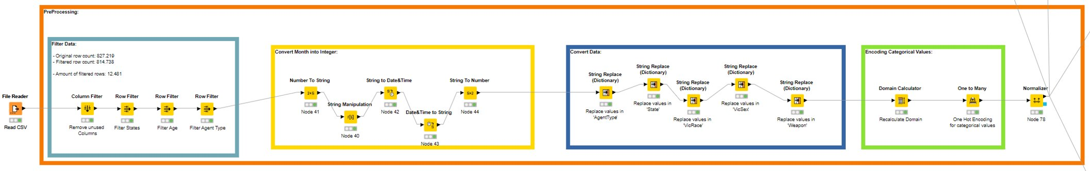
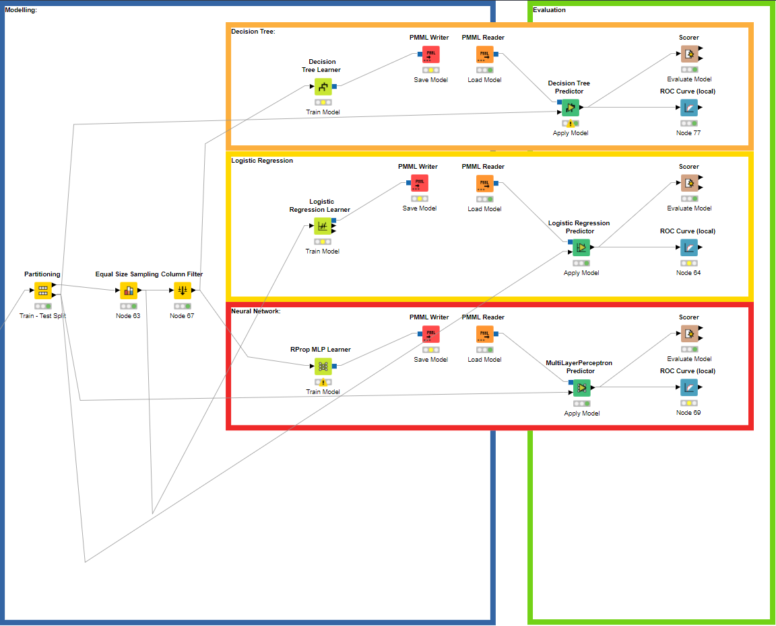
KNIME Workflow

Slide 12
Thank you

